Slide 1
YOLO on Custom Data from RoboFlow
Submitted by:
Hamna Imran (402029)
Muhammad Shah Zaib(402305)
Syed Arif Hussain(398870)

Slide 2
Custom data annotation:
Data annotation is the process of labeling individual elements of training data (whether text, images, audio, or video) to help machines understand what exactly is in it and what is important. This annotated data is then used for model training.
Custom data can be annotated using various tools like LabelMe, V7, Labelbox, Scale AI etc..
We will use RoboFlow for the annotation of custom data.

Slide 3
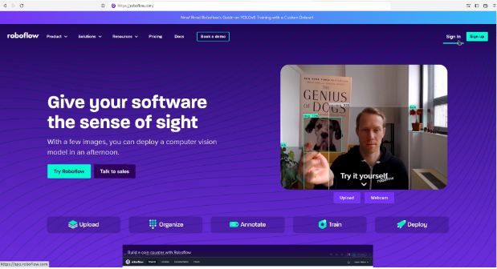
Getting Started with Roboflow
Go to the Roboflow website roboflow.com and click on Sign In

Slide 4
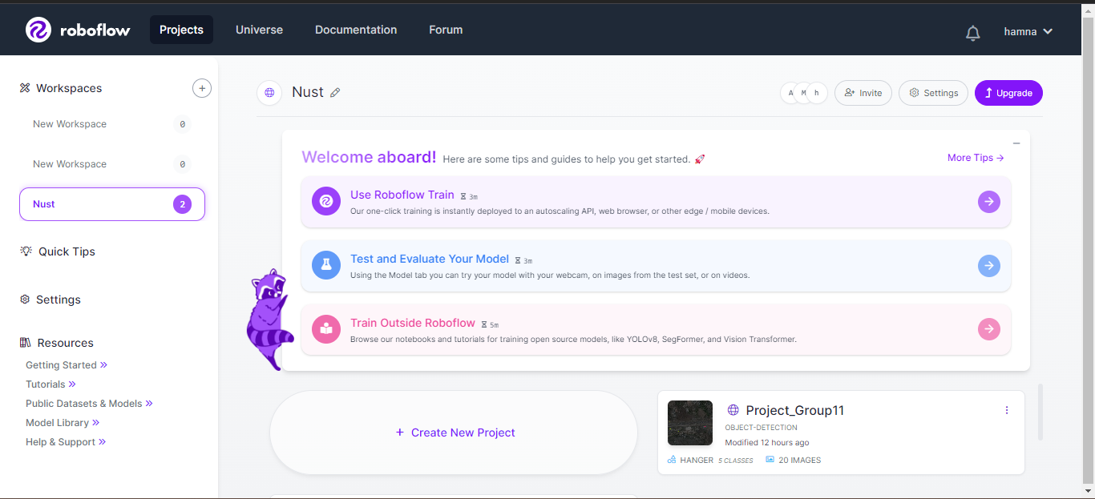
Enter your login details and it will lead you to your dashboard

Slide 5
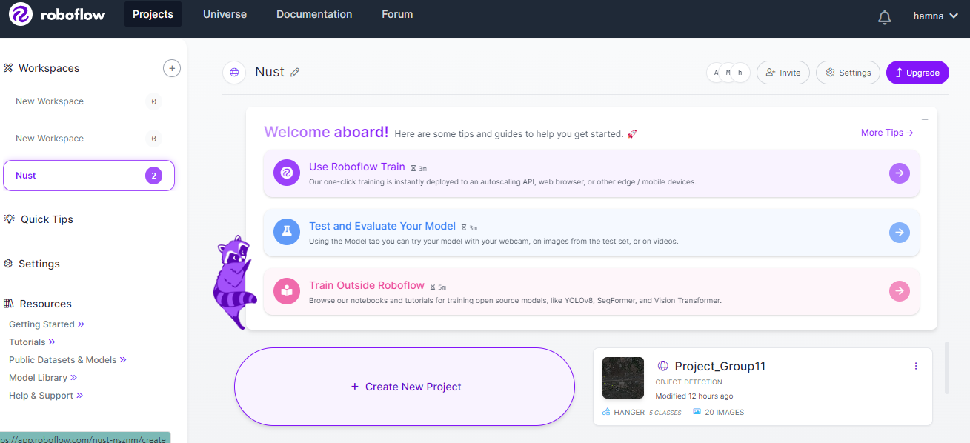
Click on Create New Project

Slide 6
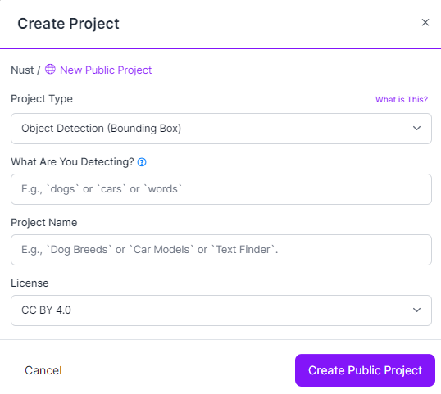
Fill in the following details and click on Create Public Project

Slide 7
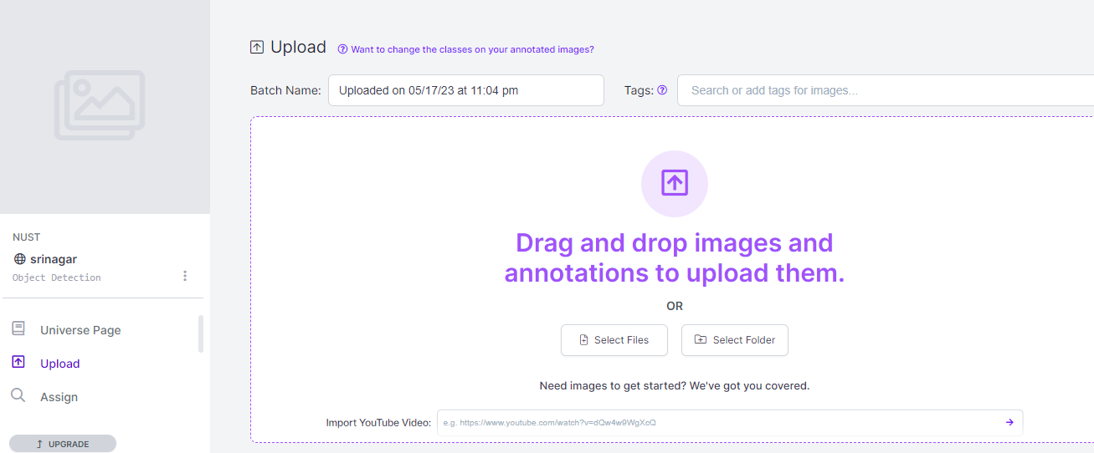
On the Upload page, click on Select Files

Slide 8
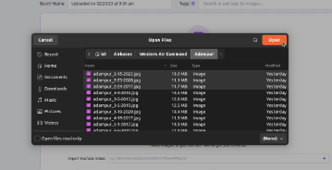
Browse to your file location and upload

Slide 9
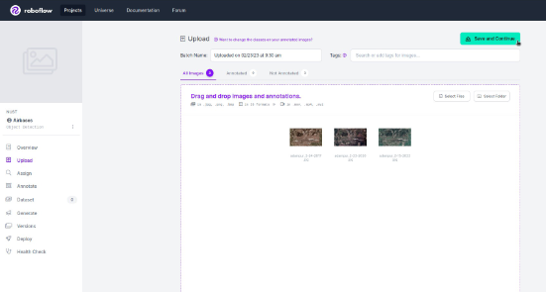
After processing, click Save and Continue

Slide 10
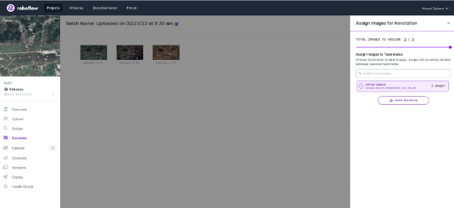
On the assignment page, select teammate and click on Assign Images

Slide 11
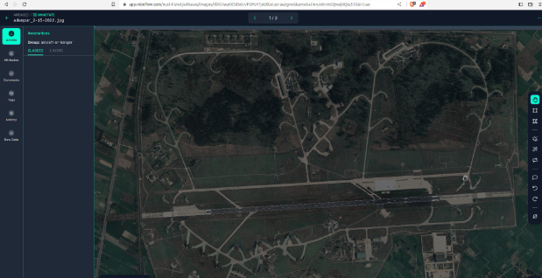
This will lead to annotation page

Slide 12
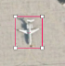
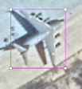
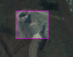
Annotation on Roboflow
Following is the list of classes and annotation technique for each class:
hanger with bounding box tool
rotorcraft with bounding box tool
narrow-body with bounding box
wide-body with bounding box
fighter with bounding box

Slide 13
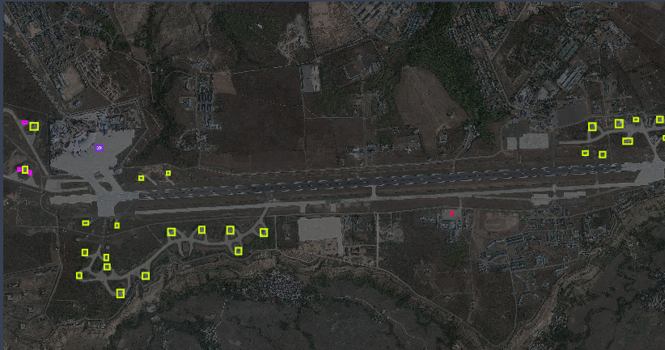

Slide 14
Steps after annotation

Slide 15
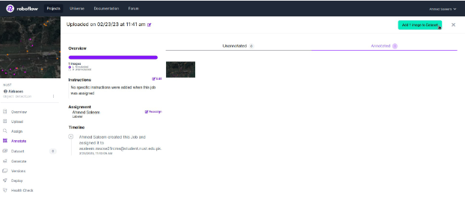
After annotating all images, click on Add image to Dataset

Slide 16
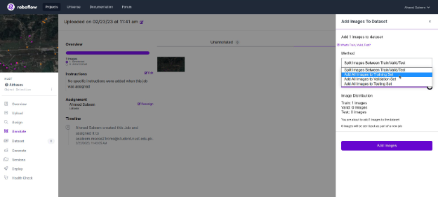
From the method drop-down menu, select Add all images to the Training set

Slide 17
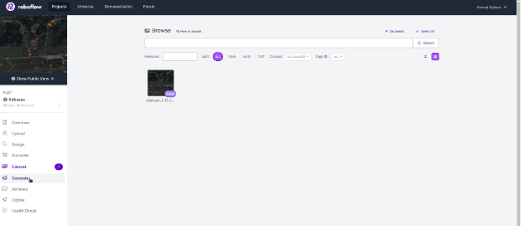
Click Add Images
Go to Generate tab

Slide 18
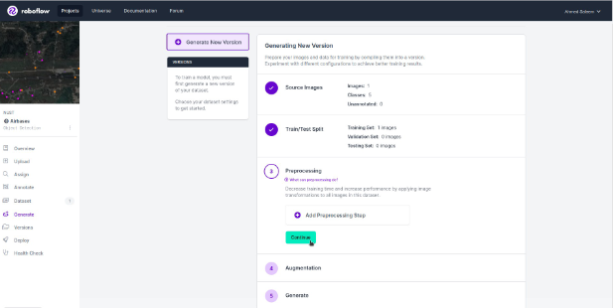
Remove any preprocessing step and augmentation step and click on Continue

Slide 19
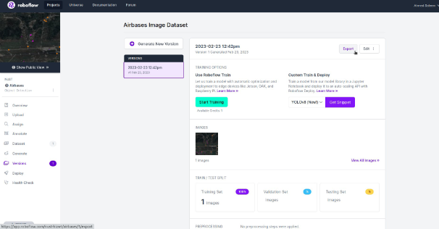
Click on Generate

Slide 20
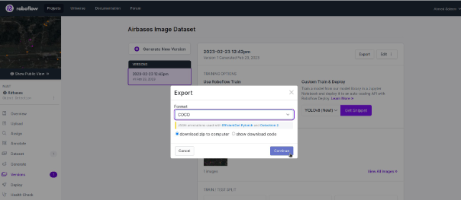
Select COCO JSON format and Download zip to computer

Slide 21
Implementation of YOLO V7 on a Custom Data Set
Steps to follow:
Installation of Dependencies​
Adding custom data​
Prepare paths in a text file​
Download pre-trained weights​
Customize model for your own data set​
Model Training​
Model Evaluation​
Model Inference

Slide 22
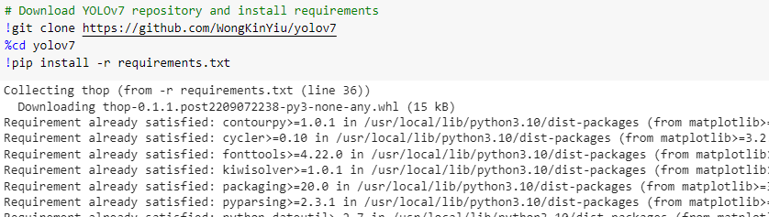
Install Dependencies

Slide 23
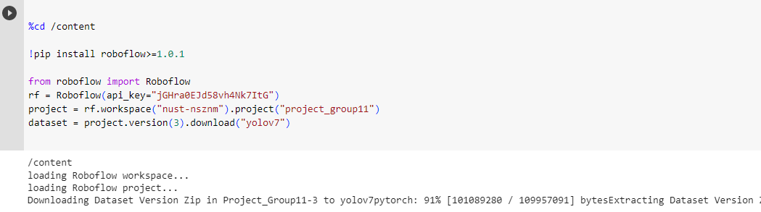
Adding Custom Data​

Slide 24
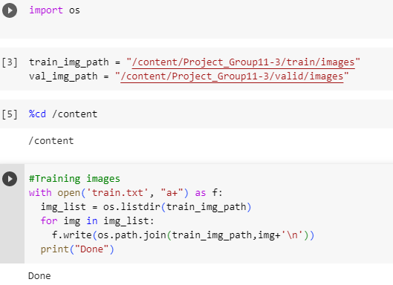
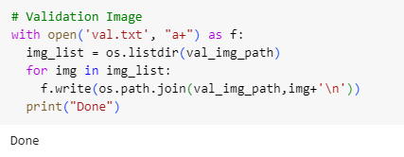
Prepare Paths in text file

Slide 25
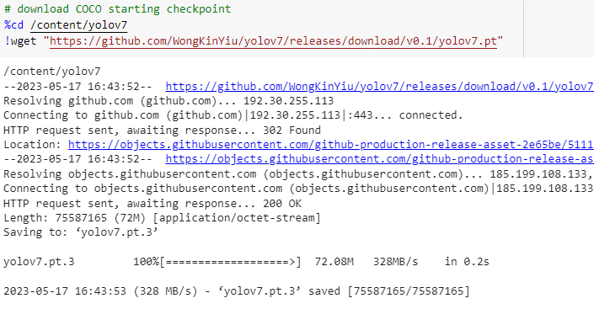
Download Pretrained Weights​

Slide 26
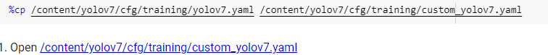
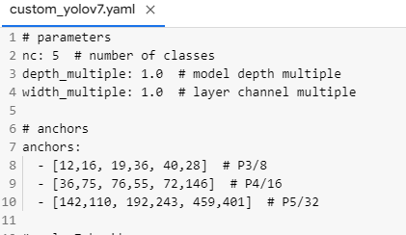
Customize model for your data set​
Open /content/yolov7/cfg/training/custom_yolov7.yaml.
On line#2, change value of nc from 80 to 5 as we have 5 classes.

Slide 27
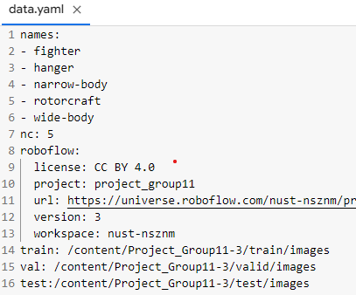
Open /content/Project_Group11-3/data.yaml
Change the train, val and test paths as shown below

Slide 28
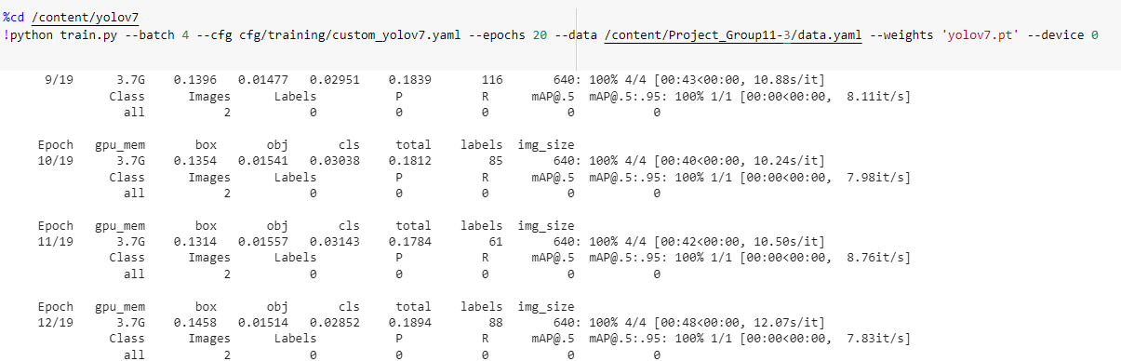
Model Training​

Slide 29
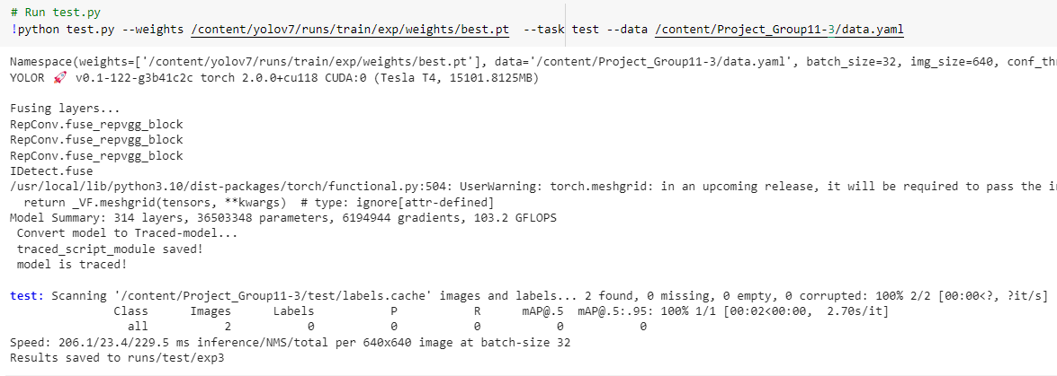
Model Evaluation​

Slide 30
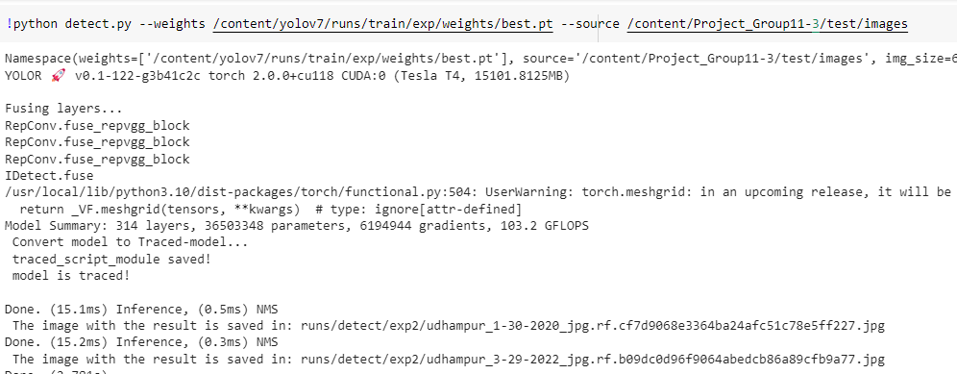
Model Inference​

Slide 31
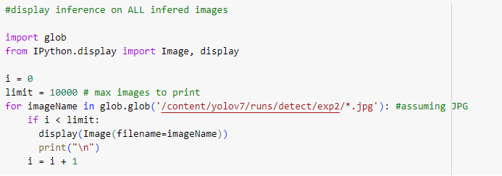
Results Visualization​

Slide 32
